Slide 1
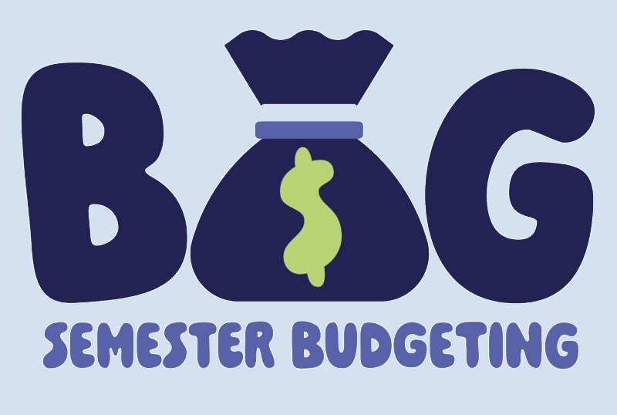
Mattea • Loffert • Paul • Joey
A Semester-Based Financial Survival System for College Students
We all fund our education differently — but we all face the same semester.
Bills don't pause. Tuition doesn't shrink.
Money runs out no matter what situation you're in.
Notes:
MATTEAS SLIDE

Slide 2
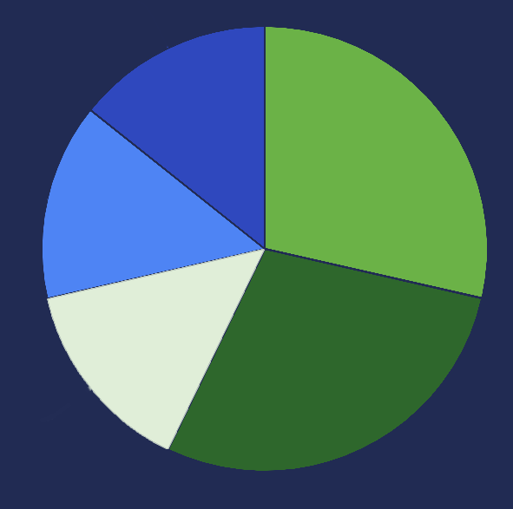
Four Students, Four Funding Systems
STUDENT LOAN
FAFSA
Mattea: MyCAA + Student Loans
Loffert: Chapter 33 GI Bill (Dependent Transfer)
Paul: FAFSA + Scholarship
Joey: FAFSA + Montgomery GI Bill
Different funding systems, same 16-week semester.
Same risk of running out.
MYCAA
SCHOLARSHIP
GI BILL
Notes:
Everyone Collab Slide
Change to graph of where students get different financial aid (anecdotes of what we use are spoken only)

Slide 3

Notes:
Matteas SLIDE
BAG isn’t just about budgeting. It’s about independence.
College is the first time many of us manage money on our own— And that can be stressful.
We didn’t build BAG because students need another finance app. We built it because students need clarity.
BAG is about giving you control and confidence.
So now, we’re going to show you how it works. Are you ready, let started…

Slide 4
The Common Problem
Expenses happen weekly
Your salary doesn’t always cover it
Aid arrives in a lump sum
The semester lasts 16 weeks
Overspending early = stress later
“The problem isn’t the amount.
It’s how you manage it.”
Notes:
JOEYS SLIDE
Financial aid usually comes in one big deposit at the start of the semester. And when that money hits—it feels like a lot.
But the semester doesn’t move in one payment.
Rent is monthly. Groceries are weekly. Textbooks hit immediately. And the semester lasts 8 to 16 weeks.
How many of you have struggled managing your money across a semester… or know what that feels like?”**
(Pause. Look around.)
**“Exactly. Most of us have.
The issue isn’t that students don’t receive money— it’s that the timing doesn’t match how real life expenses happen.

Slide 5
Why Other Services Fail
Traditional Budget Services Don’t Think in Semesters
Built around monthly budgeting
Assume consistent income
No academic calendar awareness
No pacing comparison
They show what you spent — not whether you’ll make it to finals.
Notes:
PAULS SLIDE (1MIN)

Slide 6
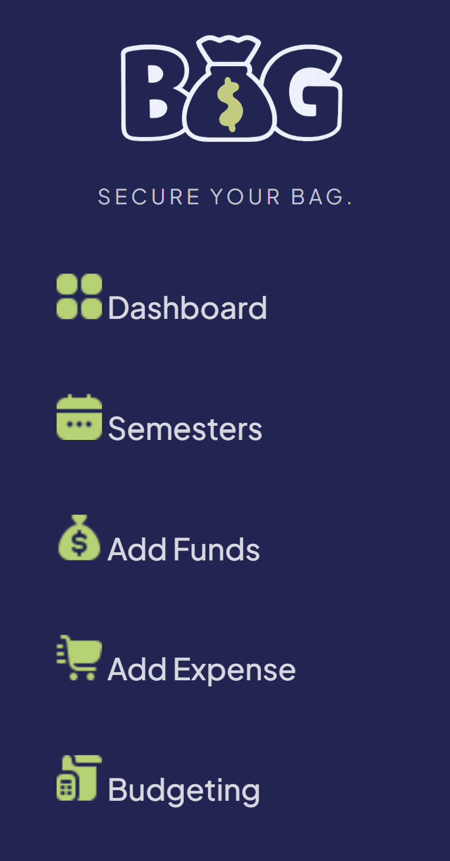
How can Bag help?
Built for Semester Life
Amount of semester complete
Track your financial aid
See % of funds used
Pace your finances across your school year in a digestible visual format
Notes:
LOFFERTS SLIDE possibly change the photo to include statements

Slide 7
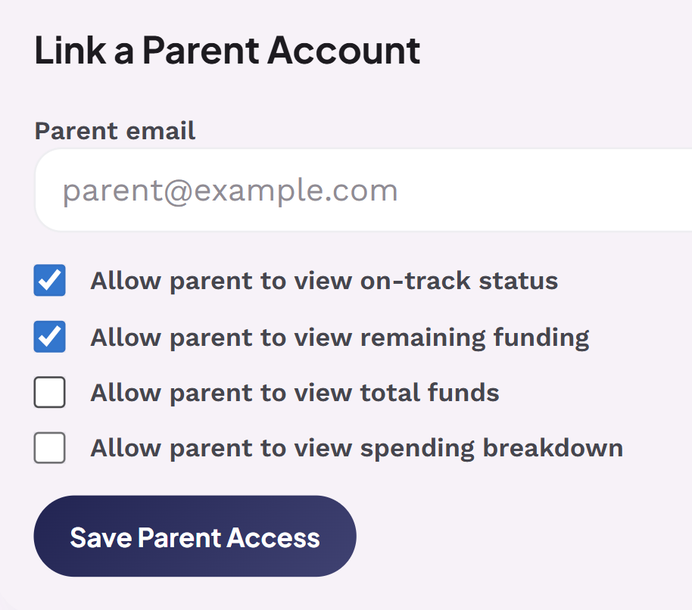
Parental Viewing - Visibility on Your Terms
Allow only what you want to be viewed
Parents cannot:
Change or restrict budgets
Log into your account
Control spending
Transparency without control.
Notes:
LOFFERTS SLIDE

Slide 8
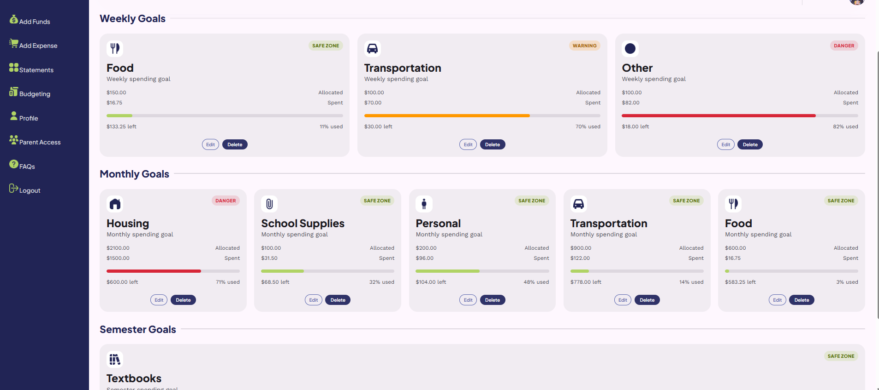
Budgeting with BAG
Budgeting goals are tailored for student’s needs
Goals can be set to a weekly, monthly, or semester track
See directly what areas you’re overspending in
When you can see where money needs to be allocated ahead of time, you can feel safer making personal purchases
Bag doesn’t just track money — it helps it last.
Notes:
PAULS SLIDE

Slide 9
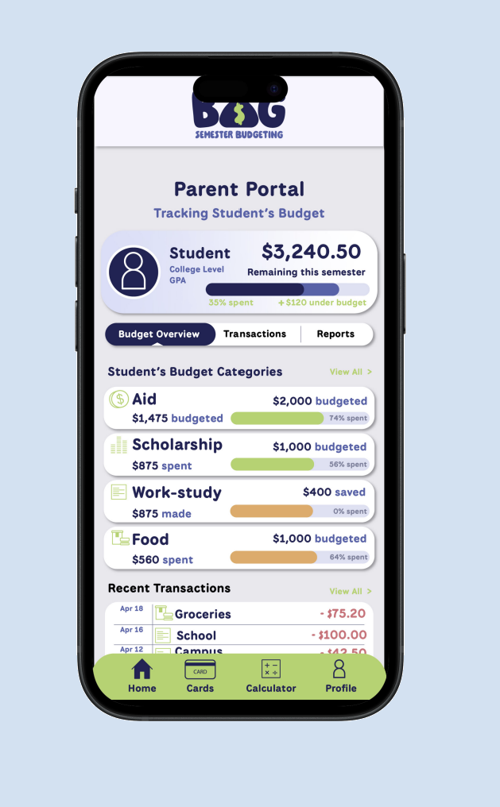
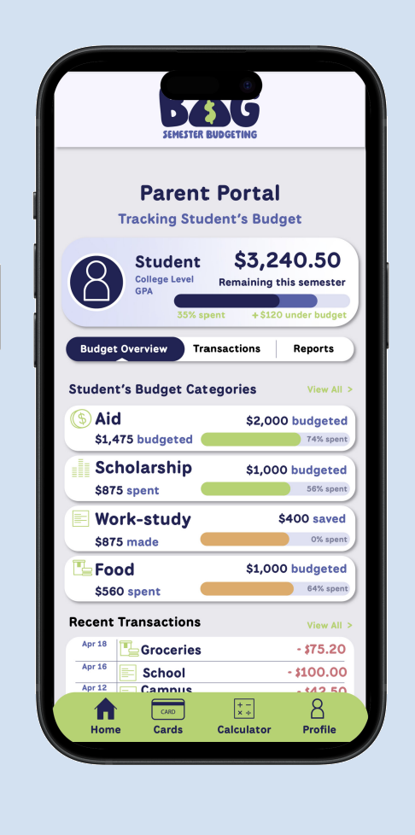
Future Implementations
Mobile app
Linking bank
Detailed Statements
Messages tab
Dark mode
Notes:
MATTEAS SLIDE
Move the triangle possibly to center photo

Slide 10


Get ready to Secure Your Bag & Own Your Independence
© 2026 Group_0 | BAG — Budgeting Aid Guide | All Rights Reserved
Presentation materials developed collaboratively by Group_0.
Notes:
JOEYS SLIDE
BAG isn’t just about budgeting. It’s about independence.
College is the first time many of us manage money on our own— And that can be stressful.
We didn’t build BAG because students need another finance app. We built it because students need clarity.
BAG is about giving you control and confidence.
So now, we’re going to show you how it works. Are you ready, let started…

